Slide 1
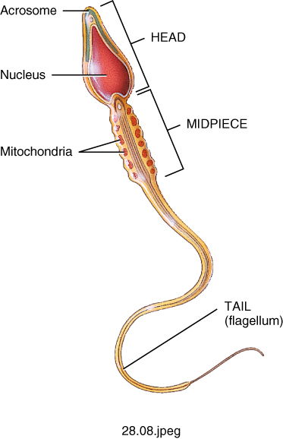
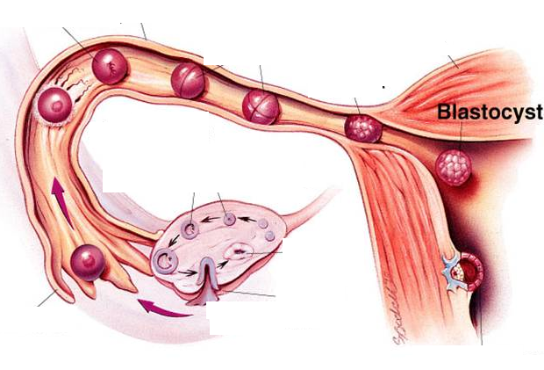
Reproductive Physiology
Lecturer Of Physiology
LECTURE NO (1)
Reproductive system
Faculty Of Medicine Dept.Of Physiology

Slide 2
OBJECTIVES
Introduction
Definition of Puberty
Onset of Puberty
Features of puberty
Secondary sex characters
Abnormalities of puberty

Slide 3
INTRODUCTION
The differences between males & females are due to the Y chromosome.
The embryo (in the 7th week of pregnancy) has both:
- The male genital duct (wolffian duct)
- The female genital duct (Mullerian duct)

Slide 4
In the presence of Y chromosome:
the testes develops, it releases testosterone, which increases development of the wolffian duct into epididymis & vas deferens; and mullerian inhibitory substance (MIS), which causes regression of Mullerian duct.

Slide 5
In the absence of the Y chromosome:
the testes does not develop. The Mullerian duct persists. It gives the uterus & the uterine tubes.

Slide 6
Puberty
Definition
- The period when the endocrine & gametogenic functions of the gonads have first developed to attain reproductive capacity

Slide 7
Onset :
Onset of puberty varies according to genetic and environmental factors. It is at the age of (9-13 y) in females and (11-15 y) in males

Slide 8
- The mechanism of onset is unknown.
- May be some sort of CNS maturation that initiates release of GnRH in a pulsatile pattern from the hypothalamus.
- This results in release of gonadotrophins (FSH & LH) from the pituitary gland.
- The gonadotrophins control functions of the gonads and release of the sex hormones (testosterone in males; estrogen and progesterone in females).
- The sex hormones result in appearance of the characteristic features of puberty

Slide 9
Features:
- Growth spurt
- Development of secondary sex characters
- Enlargement of reproductive organs
- Attainment of reproductive capacity

Slide 10
The secondary sex characters
In males:
Enlargement of internal genitalia (testes, ducts and glands) .
Enlargement of external genitalia.
Deep voice (due to enlargement of the larynx & thickening of the vocal cords ).
Growth of the hair in the :
face : beard & mustache .
Pubic area, axilla & chest.

Slide 11
Emotional changes (more active , aggressive & interested in the opposite sex).
Conformational changes (enlargement of muscles ).
Secretion of fatty glands (predisposing to acne).

Slide 12
The secondary sex characters
In females:
- Enlargement of the internal genitalia (uterus).
- Enlargement of the external genitalia.
- Enlargement of the breasts.
- The voice remain high pitched (no enlargement of the larynx).
Deposition of subcutaneous fat( specially in breasts) .
Development of pubic & axillary hair
Emotional changes & conformational changes
( broad hips with narrow shoulders) .

Slide 13
Abnormalities of puberty
Precocious puberty:
- True puberty (with gametogenesis)
- Caused by early release of gonadotrophins

Slide 14
Pseudopuberty
- Only the secondary sex characters, with no gametogenesis,
- Due to early release of sex hormones

Slide 15
Delayed puberty
- Delayed features of puberty due to delayed release of gonadotrophins or sex hormones.
- May be caused by a pituitary disorder, a chromosomal abnormality or an unknown cause

Slide 16
you
Thank

